Slide 1


INS EXPO
Aug 2023

Slide 2


Functionality & Features
A2B helps reduce costs and simplify processes by consolidating to a single platform
A2B can help businesses streamline their operations and increase innovation, giving them a competitive edge in today's fast-paced market
Transition using A2B sets the stage for a more adaptable and sustainable enterprise in the future.

Slide 3
A2B – Generative AI
Existing
In pipeline
Customers
A2B
Code converter
Converts SAS to Python/Snowflake/Bigquery etc
COBOL to Java
USQL to TSQL
Korn shell scripts to Python
C# to Python
FORTRAN to Python
PL/SQL to SNOW SQL
Multiple banks and insurance customers
Converts Informatica to Snowflake
Convert Informatica to ADF/ADB
Informatica to AWS Glue
Abinitio to PySpark
A2B
ETL migration
DataStage to ADF/ADB
Multiple banks and insurance customers
A2B
Reports converter
Converts Cognos to PowerBI
Converts Tableau to PowerBI
Converts Microstrategy to PowerBI
Converts Qlik to PowerBI
Leading Australian power sector customer
A2B
Test automation
Generates unit test cases for Java and Python
Generates test data
Selinium
Yet to implement with customer

Slide 4
SOLUTION ARCHITECTURE
A2B
Technologies used
Python
DATA BLOCK, % STATEMENTS
Accelerator
OUTPUT 1…n
SOURCE CODE
CODE PARSING
Block identification
CODE ASSEMBLING
TARGET CODE
LLM (OpenAI)
OUTPUT 1…n
PROC BLOCKS
Code conversion successful
YES
IS MATCHING?
Manual code fix
NO
Reconciliation
GLOSSARY
Code parsing : A python code which takes in the Source script and splits it into logical blocks such as data block, proc block, %let statement
A2B accelerator : A python code which takes in Data block and %let statement and convert into its equivalent PySpark code snippet
Code Assembling : A python code which takes multiple code snippets that was generated from the accelerator and LLM and assemble them into a single PySpark script.
Reconciliation : Recon tool (Python) will compare the target data of Source code with target data of Target code.

Slide 5
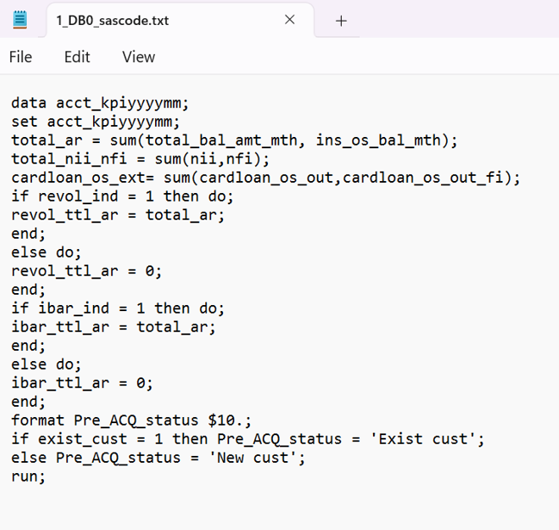
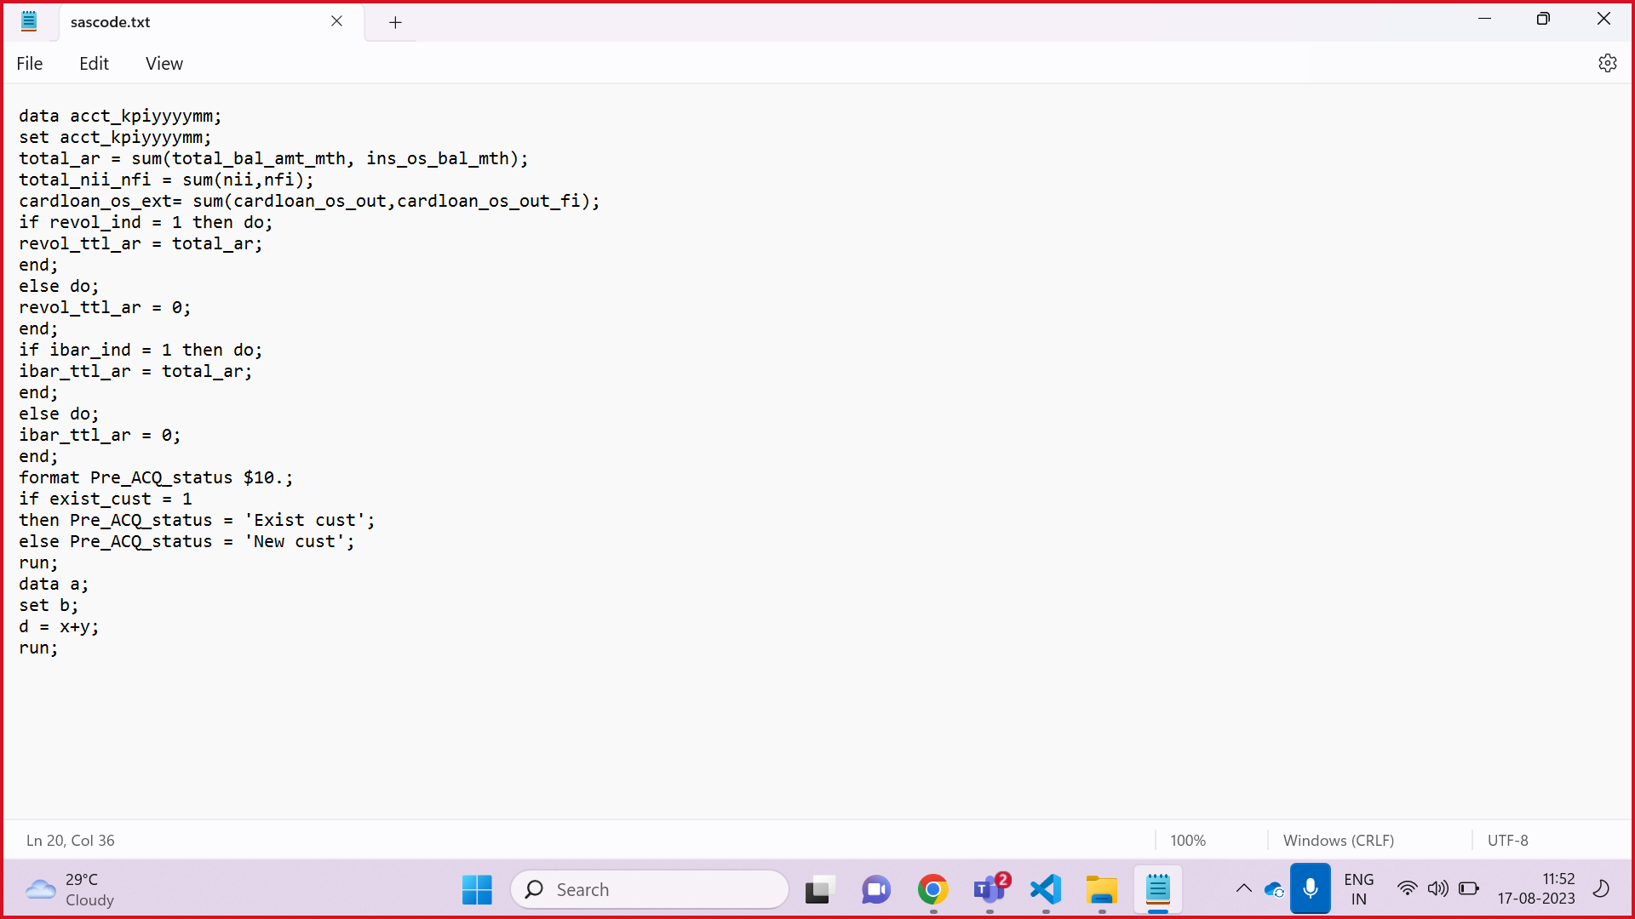
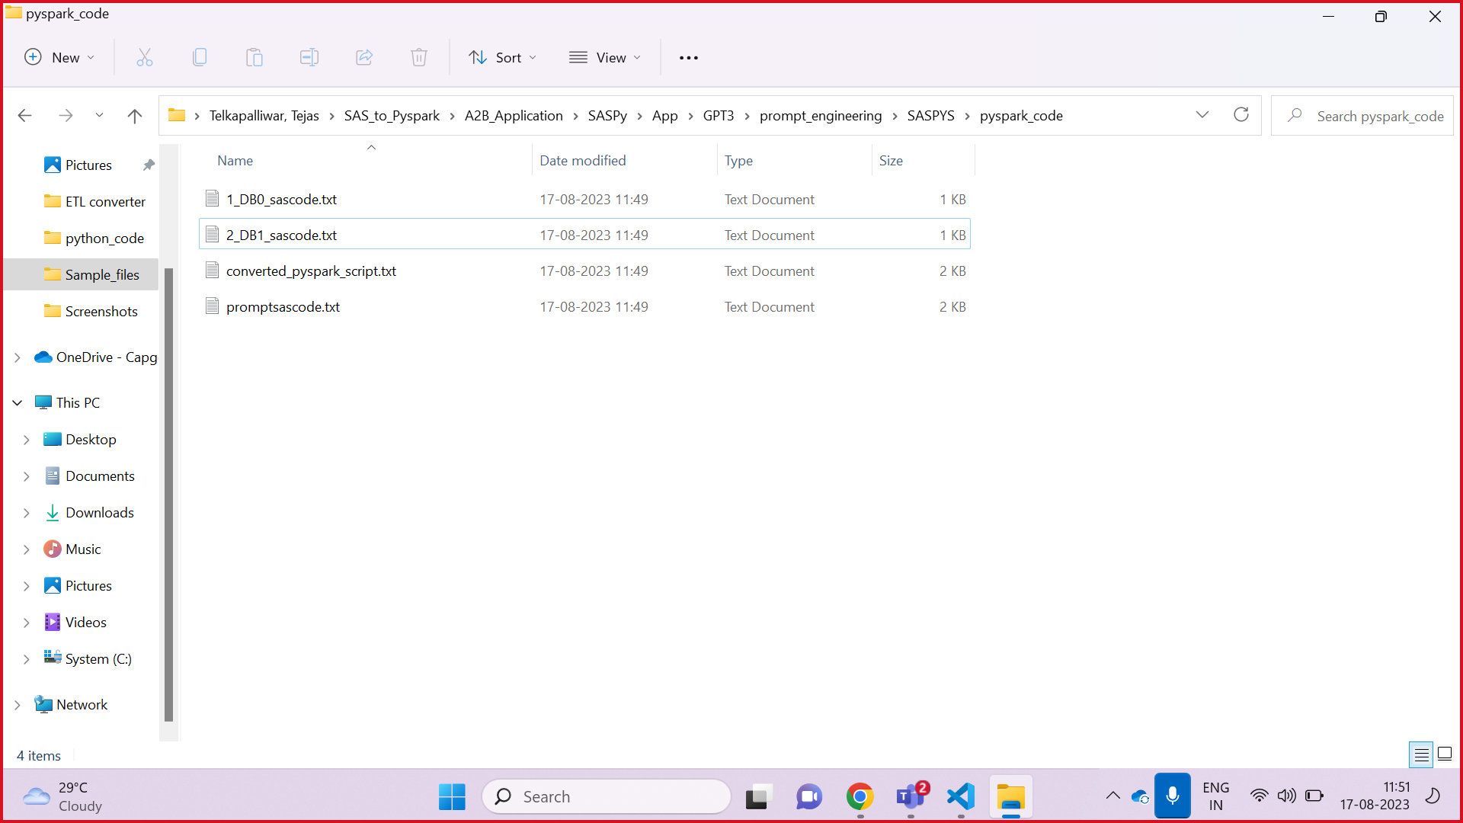
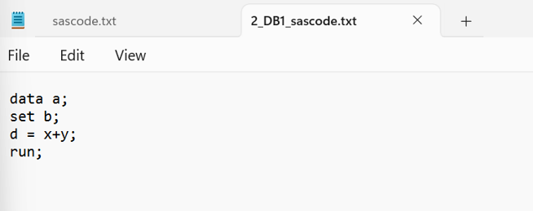
TECHNICAL FLOW OF THE CONTROL
CODE PARSING
Content of the output SAS code snippet
Parsed SAS code snippet generated from SAS input script in .txt format
Content of the SAS script input file.

Slide 6
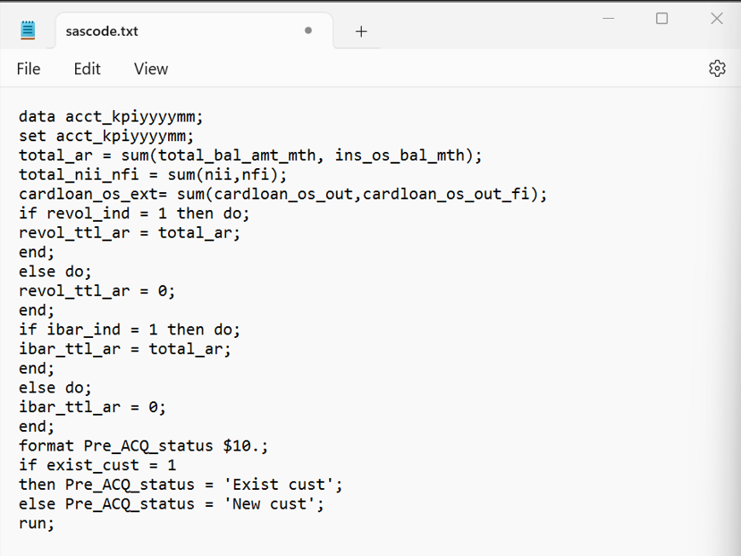
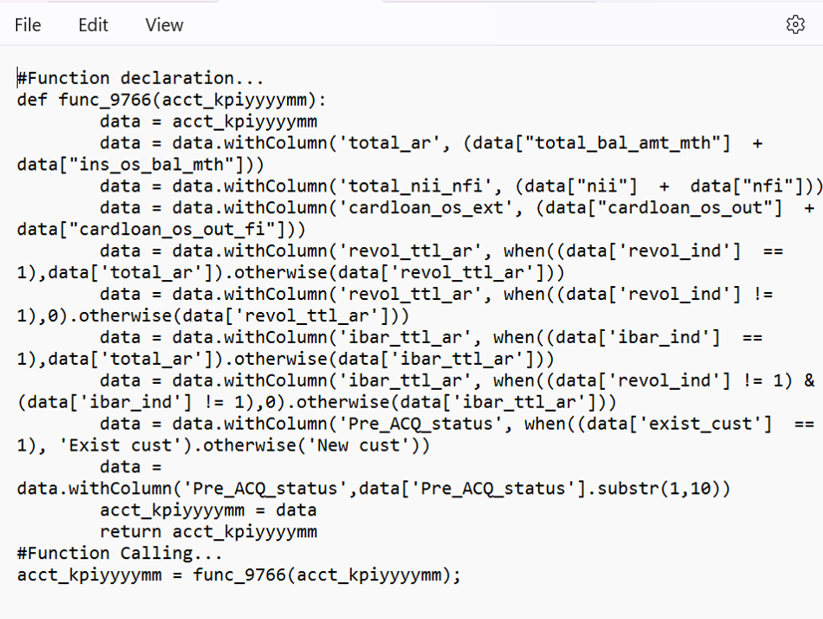
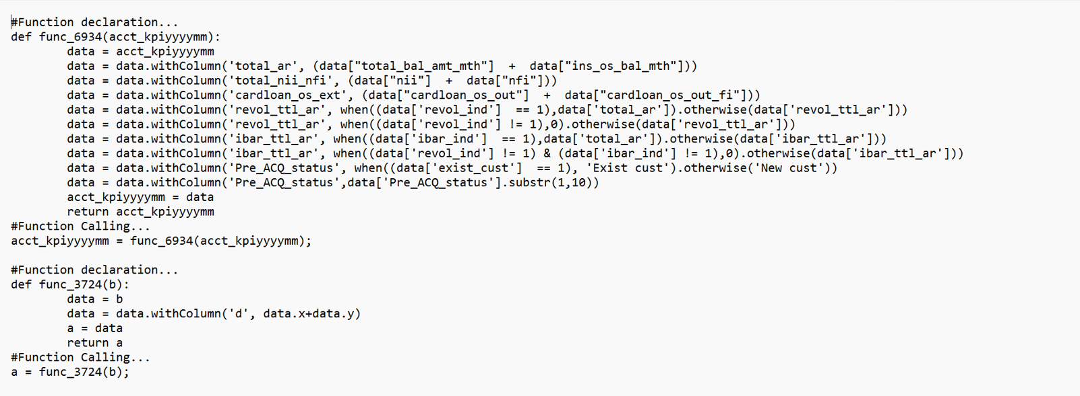
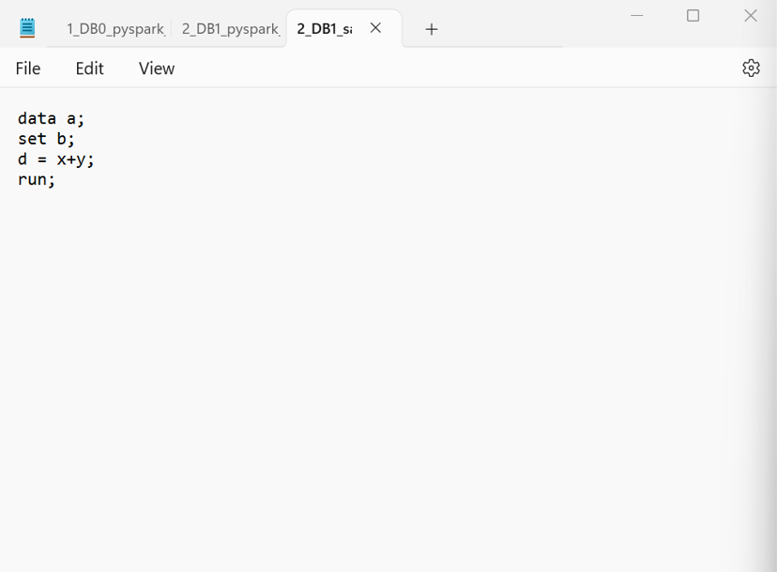
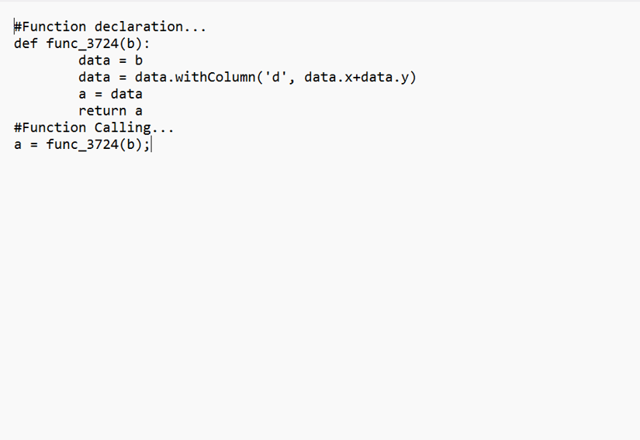
ACCELERATOR
PySpark conversion of input code snippet
CODE ASSEMBLING
Content of the parsed SAS code snippet
Equivalent PySpark script of the input SAS script

Slide 7
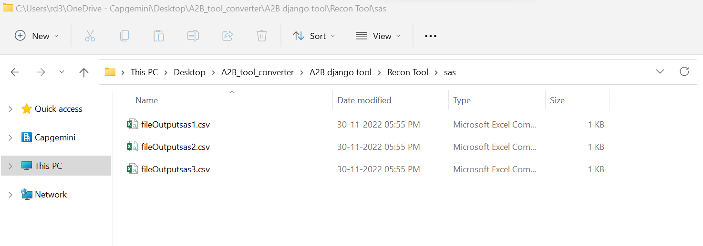
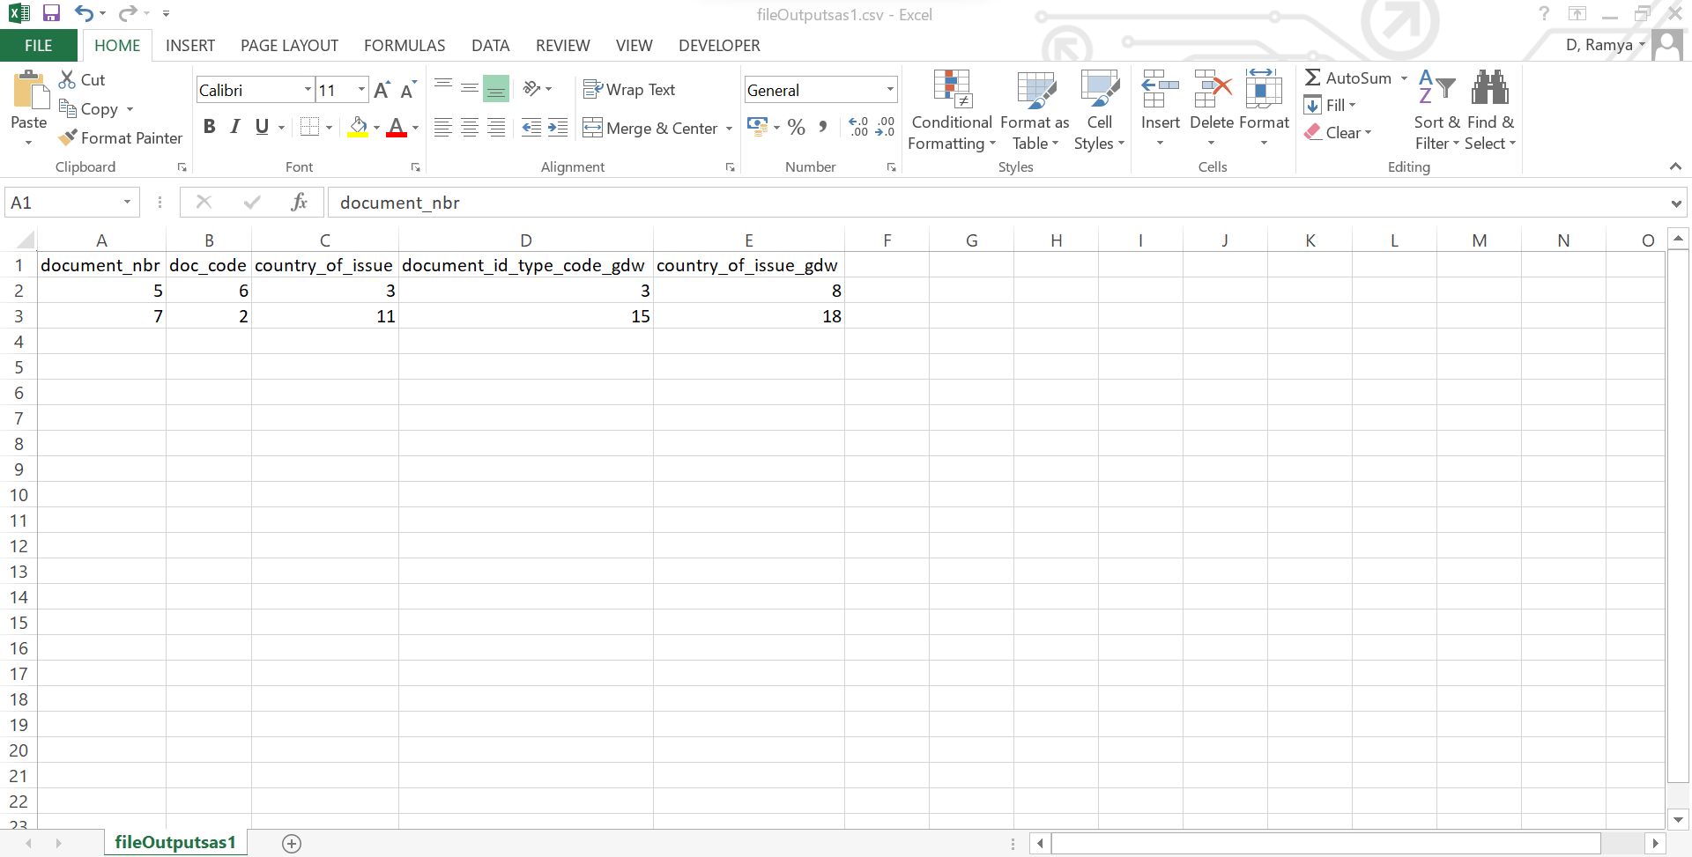
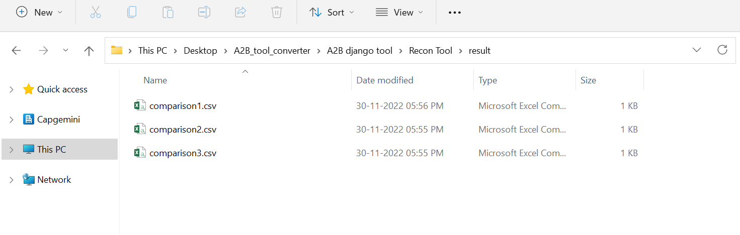
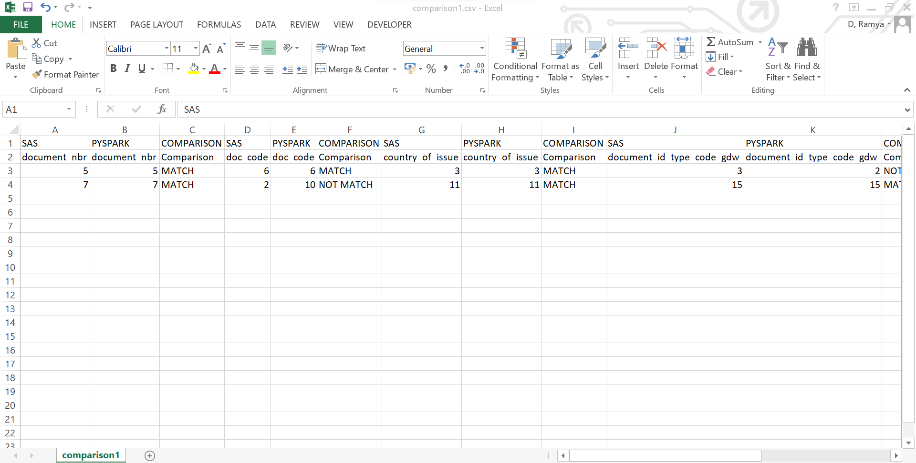
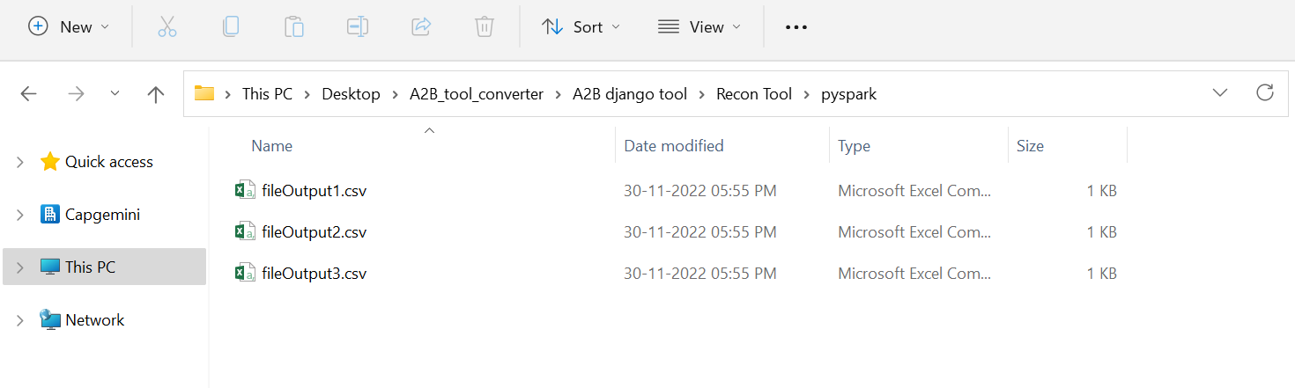
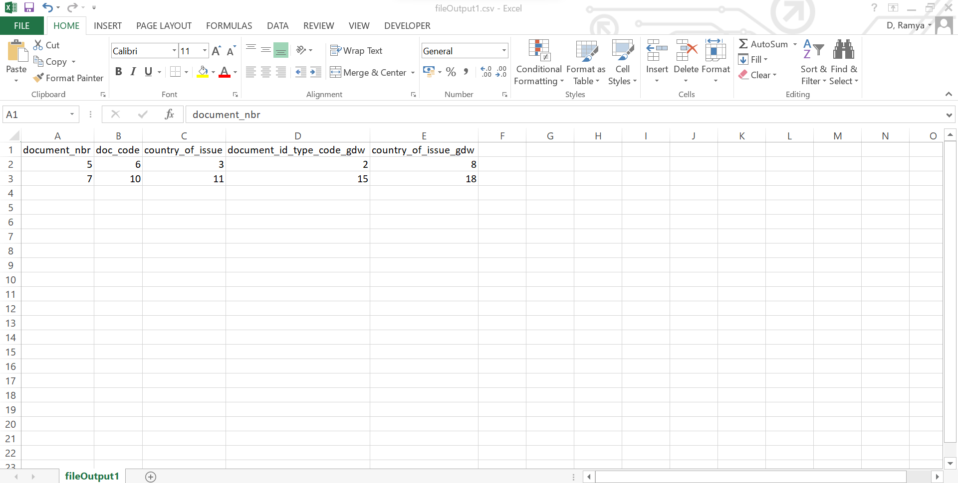
RECON
Output generated by SAS script file in .csv format
Content of the SAS script output file.
RECON Tool output in .csv format
RECON Tool output content
Record1 - Both results matches
Record2 - Result not match
Content of the pyspark script output file.

Slide 8

INFRASTRUCTURAL REQUIREMENT
LLM MODEL USED
SAS ANALYZER
A2B CONVERTER or 3rd Party
Python 3.8 or above
Pandas
xlrd==1.2.0
xlsxwriter
matplotlib-inline==0.1.3
Antlr : antlr4-python3-runtime 4.11.1
Java: JDK 18.0.2
django==3.2.8
openai==0.8.0
pandas
openpyxl
reportlab
boltons
ASSESSMENT
POC

Slide 9

Use case(s) & USP (uniqueness)
Grupo Nacional Provincial SAB (GNP) is a Mexico-based company, which is principally engaged in the insurance sector.
The range of the Company’s products and services includes insurance policies as
Direct life
Property and casualty
Health, third party liability
Fire, earthquake and catastrophe
Agricultural and automotive, etc.
In addition, the Company is active in the provision of reinsurance services.

Slide 11
A2B – Generative AI
Existing
In pipeline
Customers
A2B
Code converter
Converts SAS to Python/Snowflake/Bigquery etc
COBOL to Java
USQL to TSQL
Korn shell scripts to Python
C# to Python
FORTRAN to Python
PL/SQL to SNOW SQL
Multiple banks and insurance customers
A2B
ETL migration
Converts Informatica to Snowflake
Convert Informatica to ADF/ADB
Informatica to AWS Glue
Abinitio to PySpark
DataStage to ADF/ADB
Multiple banks and insurance customers
A2B
Reports converter
Converts Cognos to PowerBI
Converts Tableau to PowerBI
Converts Microstrategy to PowerBI
Converts Qlik to PowerBI
Leading Australian power sector customer
A2B
Test automation
Generates unit test cases for Java and Python
Generates test data
Selinium
Yet to implement with customer

